Slide 1






Churn Analysis

Slide 2


Identify the employees who are likely to leave company.
Target important factors leading to employees’ churn.
Goals

Slide 3
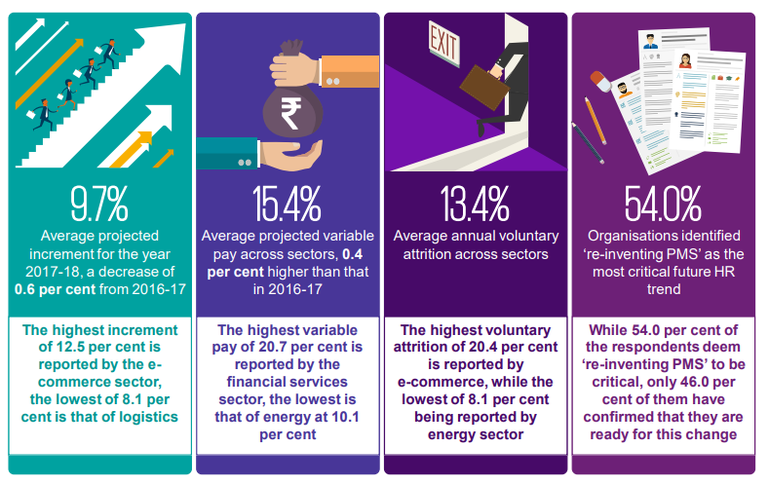


Outline
Data Review
Data Preparation
Missing Values
Feature Engineering
Exploratory Analysis
Features Selection
Cross-Validation
Data Models
Naïve Bayes
Decision Tree
Random Forest
SVM
KNN
Logistic Regression
Features Importance

Slide 4

Source
About
Details
Tools
Fictional dataset created by IBM data scientists, contains various factors responsible for attrition
1470 Rows
34 Columns
Label: Attrition-Y/N
Jupyter Notebook
Azure ML Studio
Kaggle.com

Slide 5


Slide 6


Slide 7
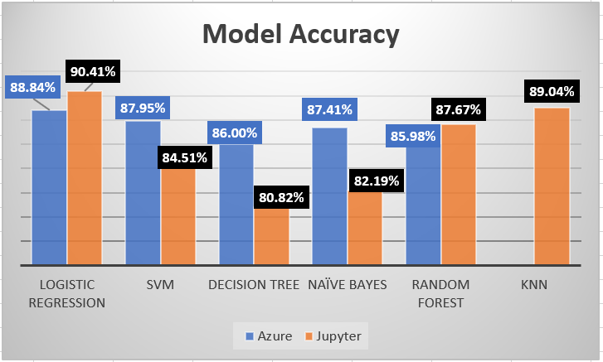
Result
Result
Factors to retain employees
Stock option level
Overtime
Business Travel
Job Involvement
Trainings

Slide 8

What went well?
What did not go well?
Cleaned dataset
Successful generation of Decision Tree Image.
Referred to websites like stackoverflow.com, Microsoft Azure tutorials, professor’s notes etc.
Good team work
Fictional biased dataset
Struggle with R script to visualize all the ROCs in one graph for easy comparison in Azure.
Unavailability of visualization tools and documentation in Azure.
Less portability of Azure file.

Slide 9

Questions???

